Slide 1


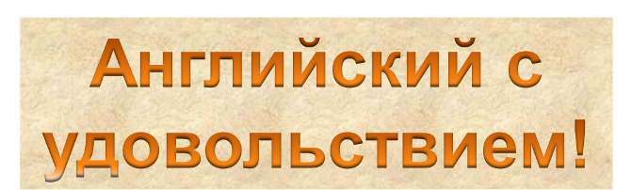



Slide 2
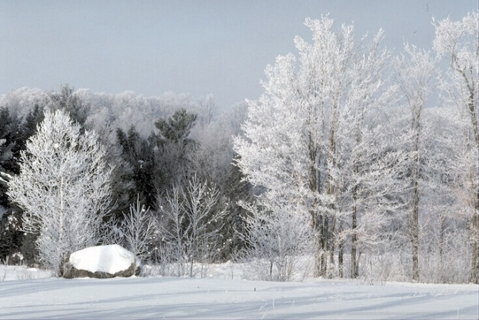
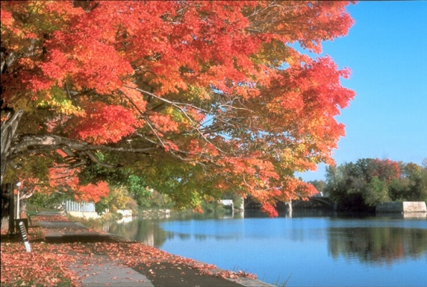


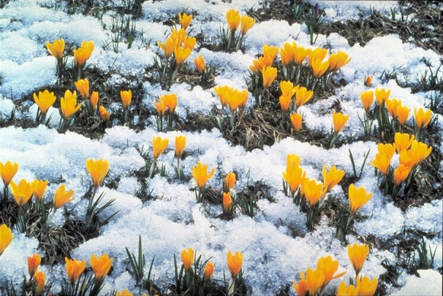


Slide 3

SPRING
WINTER
seasons
and months
AUTUMN
SUMMER

Slide 4
duck
[d] – [d] – [d]

Slide 5

[b] – [b] – [b]
bear

Slide 6
[t] – [t] – [t]
elephant

Slide 7

[r] – [r] – [r]
rain

Slide 8
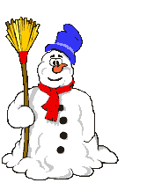
[s] – [s] – [s]
snowman

Slide 9
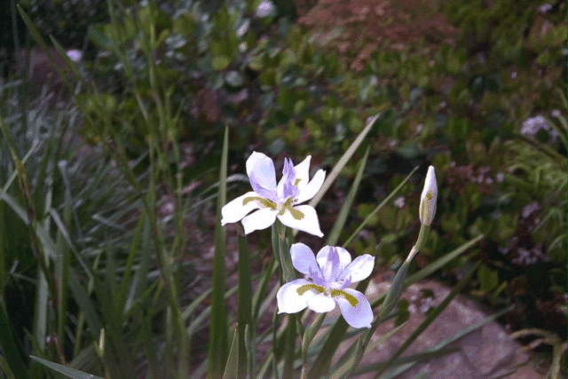

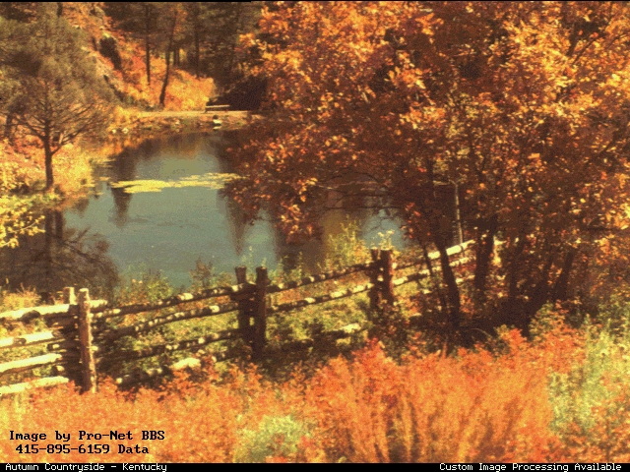
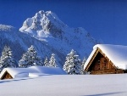
Spring is green,
Summer is bright,
Autumn is yellow,
Winter is white.

Slide 10
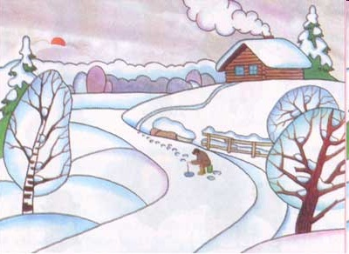

Winter months are
December
January
February

Slide 11
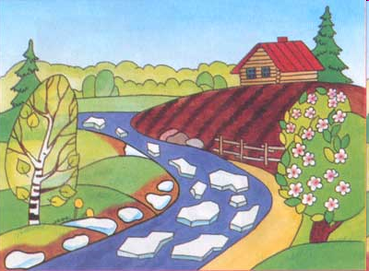
Spring months are
MARCH
APRIL
MAY

Slide 12
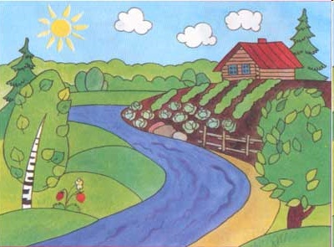
Summer months are
June
July
August

Slide 13
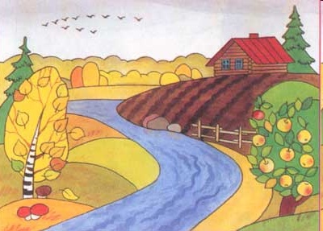
Autumn months are
September
October
November

Slide 14
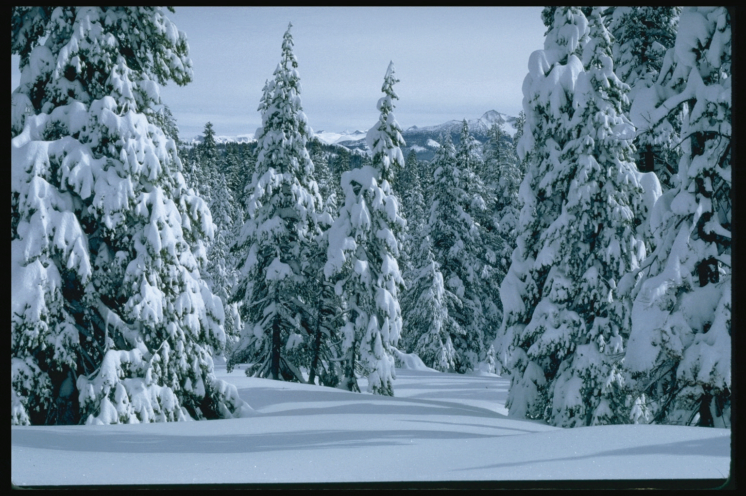




What are winter months?
winter months are…

Slide 15

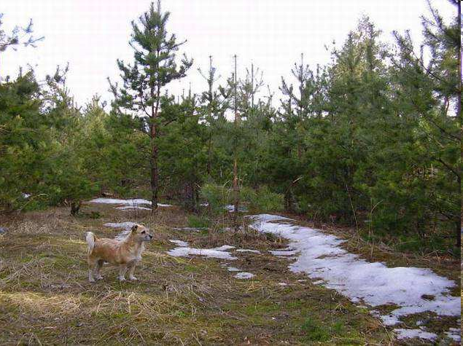
What are spring months?
Spring months are…

Slide 16
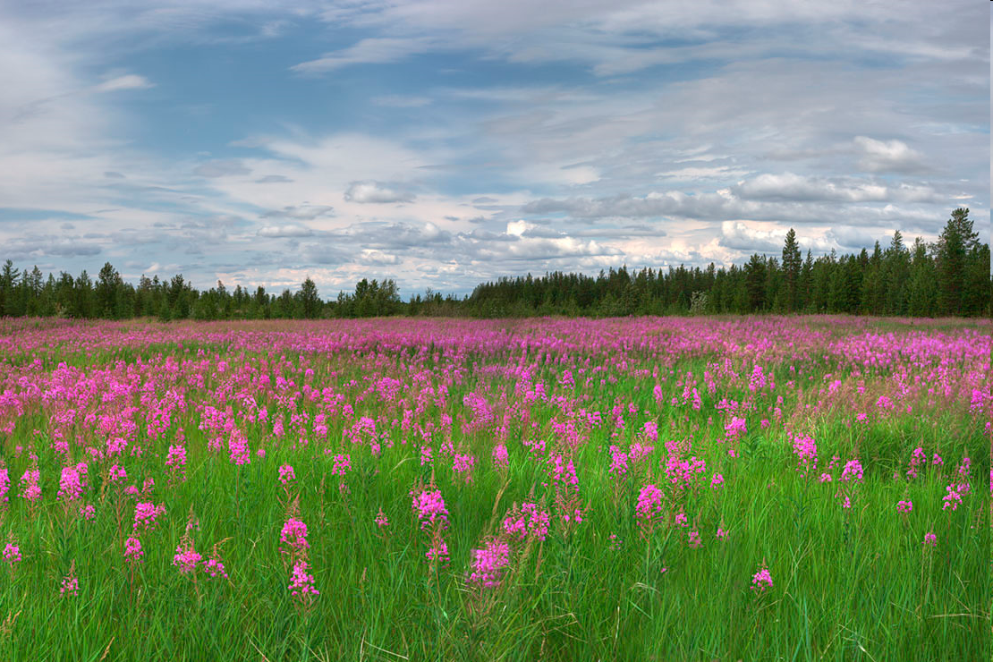


What are summer months?
Summer months are…

Slide 17

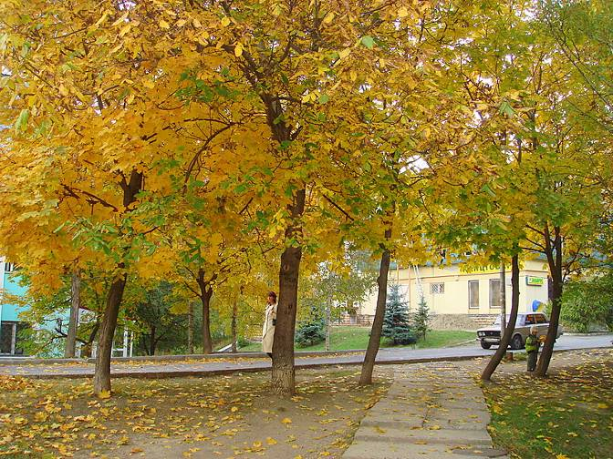
What are autumn months?
Autumn months are…

Slide 18
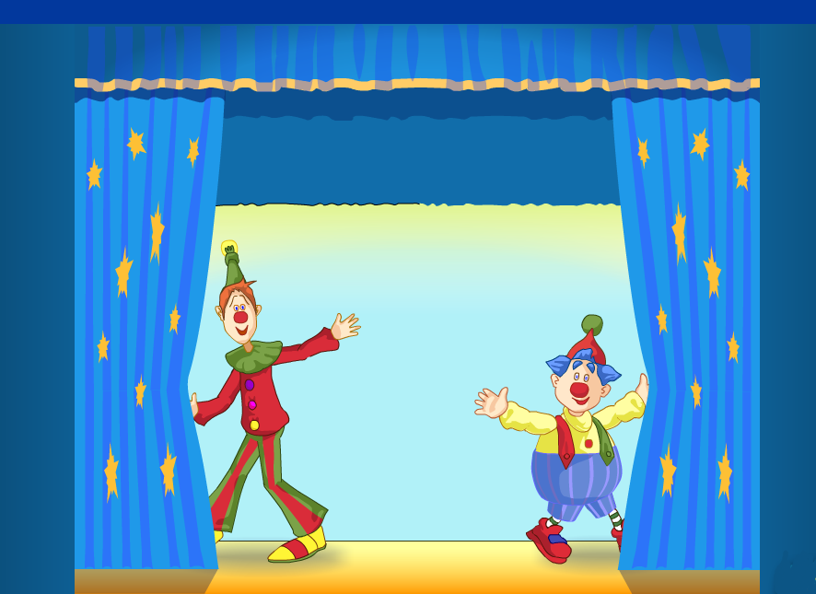



Good bye!

